Slide 1

Project Title –Netflix Data Analysis
MOHAMMED MAAZ UDDIN
INTERNSHIP_172663295366ea53f910591

Slide 2

PROBLEM STATEMENT
Netflix has become one of the most prominent global streaming platforms, continuously expanding its library with a mix of original productions and licensed content. However, with growing competition from platforms like Amazon Prime, Disney+, and regional OTT providers, Netflix must strategically analyze its content catalog to identify strengths, gaps, and opportunities.
The specific problem to be addressed in this project is 'Content Trends Analysis for Strategic Recommendations'. The aim is to uncover how Netflix’s content distribution (Movies vs. TV Shows, genres, and country contributions) has evolved over the years. This will enable the identification of key genres, audience preferences, and strategic insights into global content expansion.

Slide 3
Project Description
Netflix is one of the leading global streaming platforms, offering a rich mix of original and licensed content. As competition grows from Amazon Prime, Disney+, and other OTT services, Netflix needs a clear view of its content strengths and gaps.
This project analyzes how Netflix’s content library—across movies, TV shows, genres, and countries—has changed over time. The insights will help reveal audience preferences, identify popular content trends, and guide strategic decisions for global content expansion.

Slide 4

WHO ARE THE END USERS?
Netflix Strategic Teams – Executives and decision-makers who plan content acquisition, production, and global expansion strategies.
Content Analysts – Teams that monitor viewing trends, genre performance, and regional content demand.
Marketing Teams – To tailor promotional campaigns based on popular genres, regions, and content types.
Business Analysts & Data Scientists – Who need insights to support data-driven decision-making.
Investors & Stakeholders – Interested in understanding growth areas and content performance.

Slide 5

Technology Used
Python – For data processing, analysis, and visualization.
Pandas – To clean, organize, and manipulate the dataset.
NumPy – For numerical computations and statistical analysis.
Matplotlib & Seaborn – To create visualizations showing trends in Netflix’s content library.
Google Colab – For interactive analysis and project presentation.
Git & GitHub – For version control and project collaboration.

Slide 6
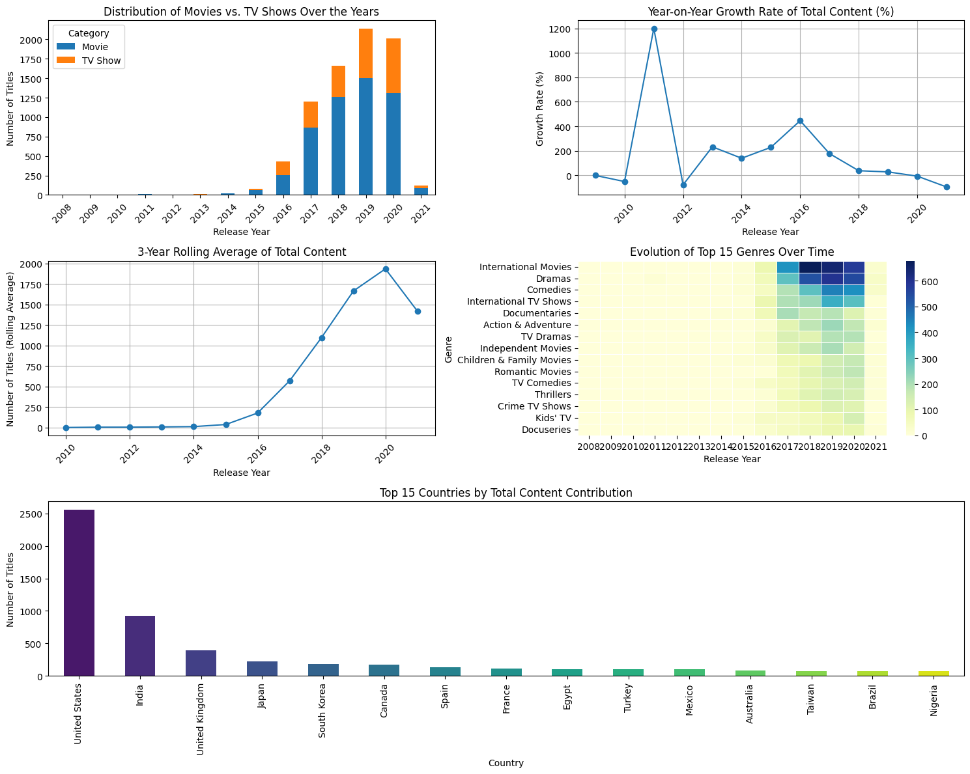
RESULT 1

Slide 7
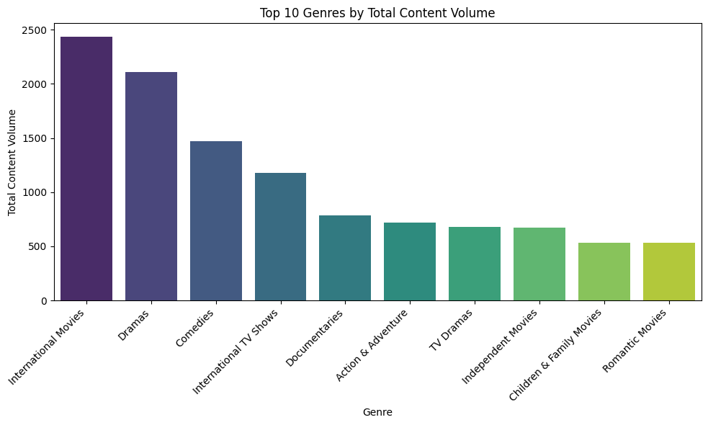
RESULT 2

Slide 8
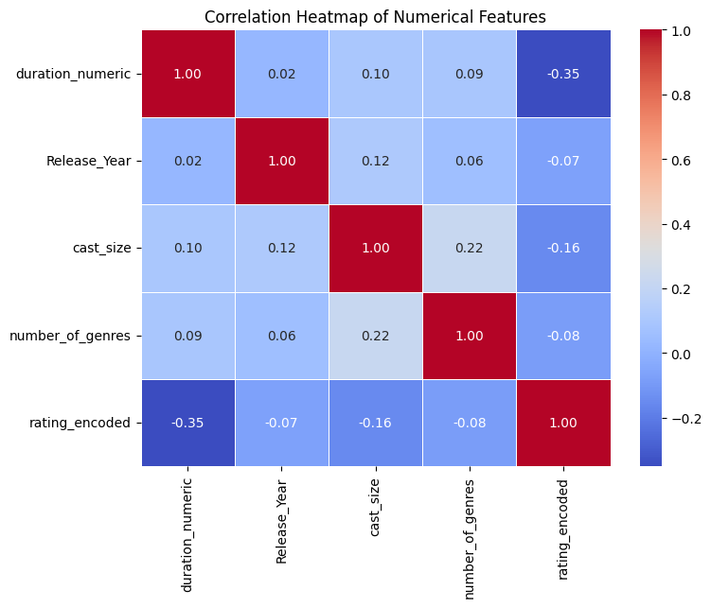
RESULT 3

Slide 9
GitHub repository
GitHub URL:
https://github.com/uddinmohammedmaaz-code/VOIS_AICTE_Oct2025_MajorProject_-MOHAMMED-MAAZ-UDDIN.git

Slide 10

Getting started with Basics of Python Certificate

Slide 11
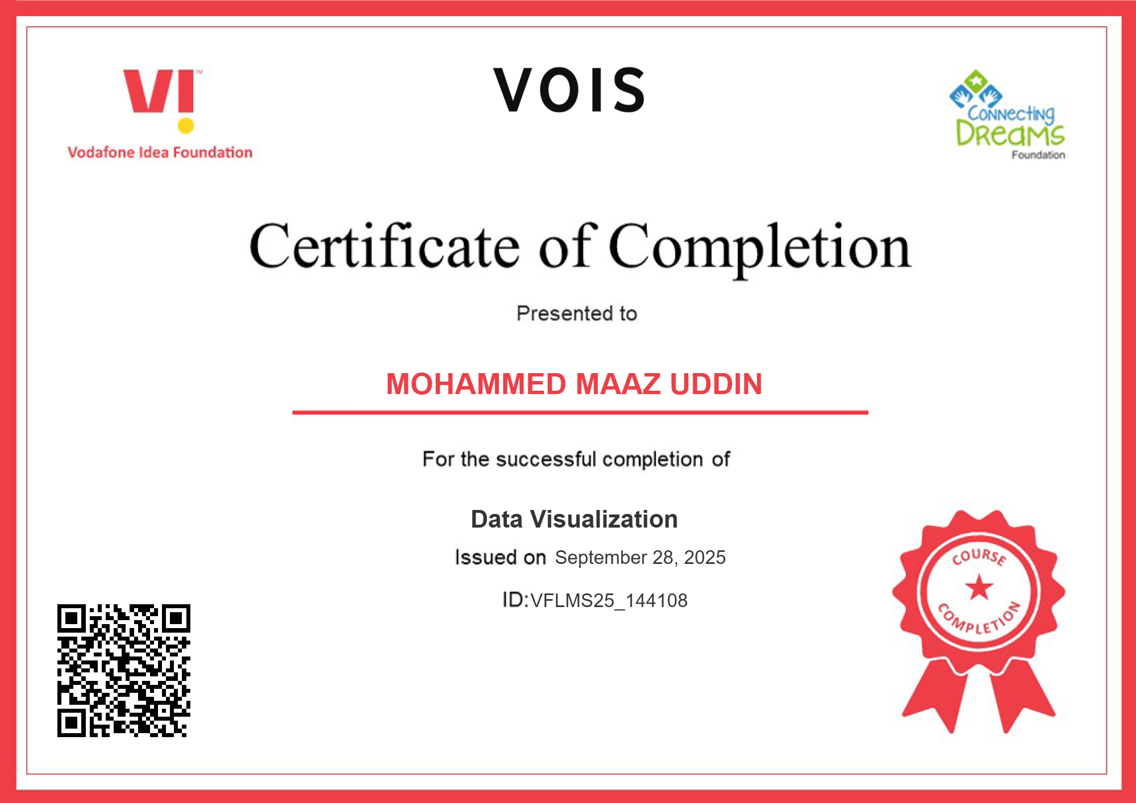
Data Visualization Certificate

Slide 12
Thank you
.
.

